Slide 1
Wavecon Telecom Analysis
Impact of 5G | Ritesh Swami

Slide 2
Content
About Company
Objective
Revenue Impact Analysis
KPI Performance
Plans Performance

Slide 3
Wavecon Telecom
Strong Presence: WaveCon Telecom is a leading telecom provider in major Indian cities.
Reliable Services: Offering cutting-edge services to meet the evolving needs of customers.
Wide Reach: Serving prominent cities like Mumbai, Delhi, Kolkata, Bangalore, and more.
5G Pioneer: Launched 5G services in June 2022, expanding network capabilities.
Diverse Plans: Introduced 13 plans tailored for both 4G and 5G users.

Slide 4
Objective
Quantify
Quantify the increase or decrease in revenue post-5G launch.
Underperforming
Identify the key performance indicator (KPI) that has not met expectations.
Plan
Highlight the plans that have generated significant revenue. Analyze the plans that have not achieved desired revenue targets.
Analysis
Assess the impact of 5G launch on specific plans. Determine whether to retain or discontinue underperforming plans.
Explain
Explain the factors leading to the discontinuation of any plans.

Slide 5
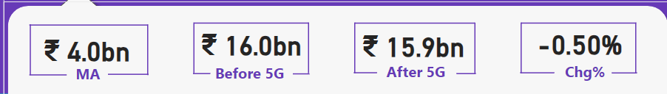
Revenue Impact Analysis
Total Revenue Before 5G: ₹16.0 billion
Total Revenue After 5G: ₹15.9 billion
Change: A decrease of 0.50% in revenue after the 5G launch.
MA - Monthly Average

Slide 6
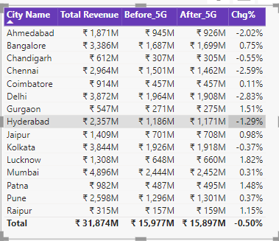
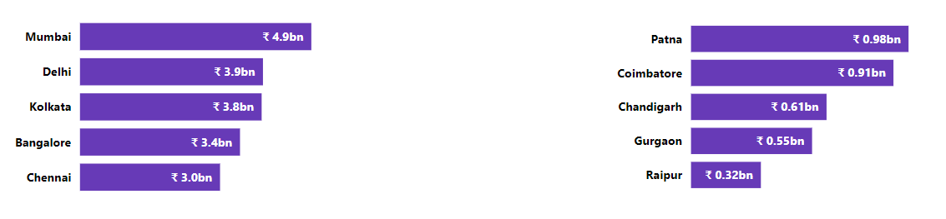
City Revenue
Highest Revenue Contributor: Mumbai generated over 4800M in revenue.
Lowest Revenue Contributor: Raipur contributed the least amount to the overall revenue.
Top 5 Cities Revenue
Bottom 5 Cities Revenue

Slide 7
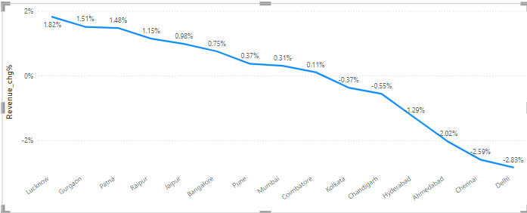
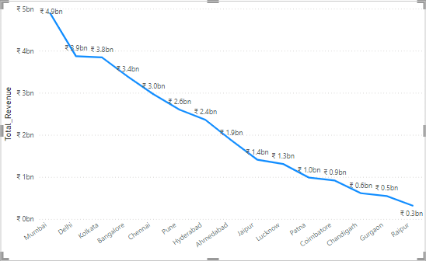
City Revenue change %
City Total Revenue

Slide 8
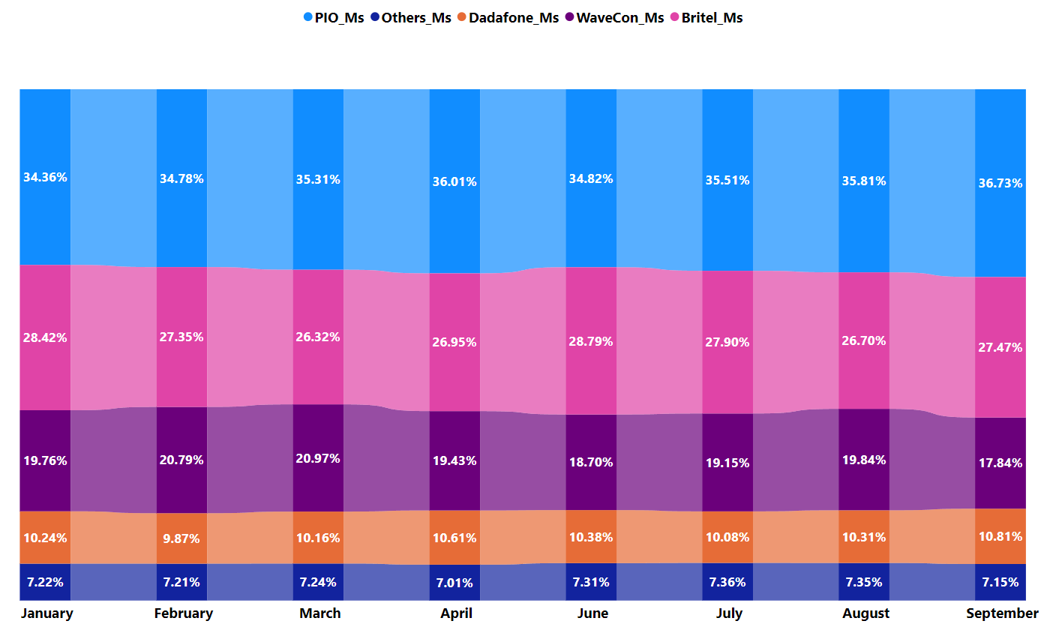
Market Share
WaveCon experienced varying market share throughout the year. It reached its highest point at 20.97% in March but gradually declined to 17.84% by September. Interestingly, there was a slight uptick after the introduction of 5G services in June.

Slide 9
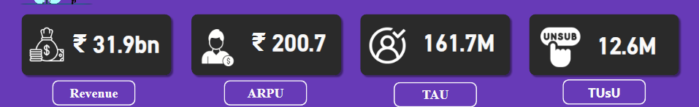
KPI Performance
WaveCon Telecom generated a revenue of 31.9 billion rupees.
Average Revenue Per User (ARPU) of 200.7 rupees.
The Total Active Users (TAU) amounted to 161.7 million.
Total Unsubscribed Users (TUsU) reached 12.6 million across various cities and months.

Slide 10

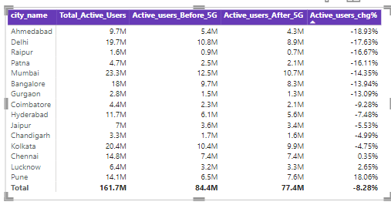
Underperforming KPI (TAU)
Total active user has drop by 8.28% from 84.4M before to 77.4M.

Slide 11
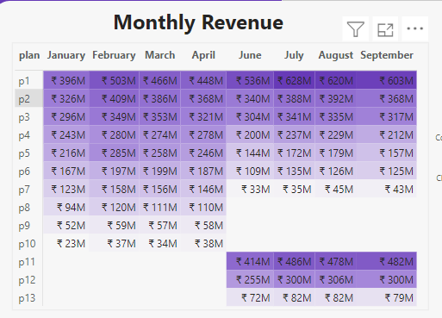
Plans Performance
Long-Duration Plans: Plans P1, P2 and P3 have not seen significant churn due to their long durations and customer inertia.
New Plan Success: Plans P11, P12, and P13, introduced recently, have demonstrated promising performance.
Discontinued Plans: Plans P8, P9, and P10 were discontinued due to a lack of substantial growth or performance.

Slide 12

Plan affect
P4, P5, P6 are slightly declined we can make few modification in them.
P7 is largely affected its revenue 146 decreased to 33M.
We can discontinue P7.

Slide 13
Plan Discontinued
P8: Daily Savior: Despite increasing revenue, the plan was discontinued. We recommend reconsidering its continuation due to its potential value proposition.
P9: Combo Top-Up: The low revenue generated by this plan suggests a need for optimization or discontinuation.
P10: Big Combo Pack: While initial revenue was low, it showed signs of growth. A more extended observation period could have revealed its potential.

Slide 14
Thank You

